Slide 1


SPARK V
Introduction to LCD Interfacing
By Pawankumar Suryawanshi

Slide 2
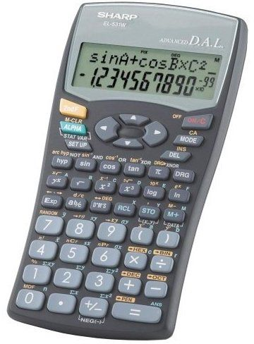
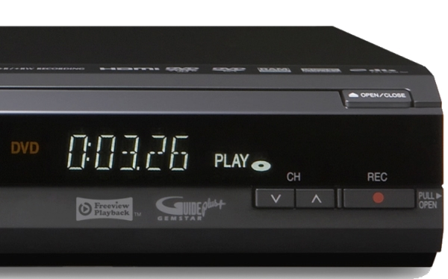
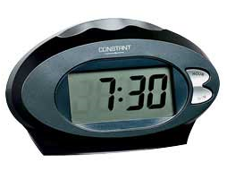
Liquid Crystal Display (LCD)
A liquid crystal display (LCD) is a thin, flat panel used for electronically displaying information such as text, images, and moving pictures.
LCDs have become a cheap and easy way to get text display for an embedded system Common display are set up as 16 to 20 characters by 1 to 4 lines.

Slide 3
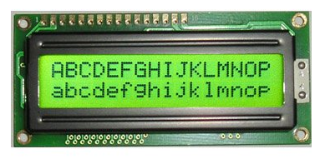
Dot Matrix Liquid Crystal Display
LCD used here has HD44780 dot matrix lcd controller. It is also called 16x2 Alpha Numeric LCD.
It can be configured to drive a dot-matrix liquid crystal display under the control of a 4 or 8-bit microprocessor.

Slide 4
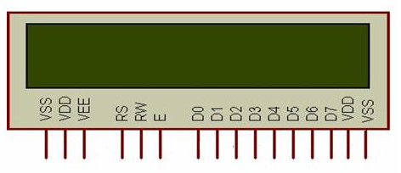
Pin Configuration of LCD
Pin | Description
VSS | Ground
VDD | Supply Voltage (5Volts)
VEE | Contrast Voltage
RS | Register Select
RW | Read/Write
E | Enable
D0-D7 | Bidirectional Data Bus
VDD,VSS | Back Light Supply (LED+, LED-)

Slide 5
Understanding LCD
Control Lines:
Register Select
If RS=0 ; Command Register
If RS=1 ; Data Register
Read/Write
If RW=0 ; Write Mode
If RW=1 ; Read Mode
Enable
Used to latch the data present on the data pins.
A high-to-low edge is needed to latch the data.

Slide 6
Understanding LCD
Data Lines:
There are 8 data pins from D0 to D7
Bidirectional Data / Command Pins
Alpha Numeric Character are sent in ASCII format.
We can use LCD either 8 bit mode or 4 bit mode.
If we use 4 bit mode then only D4 to D7 data pins are use.

Slide 7
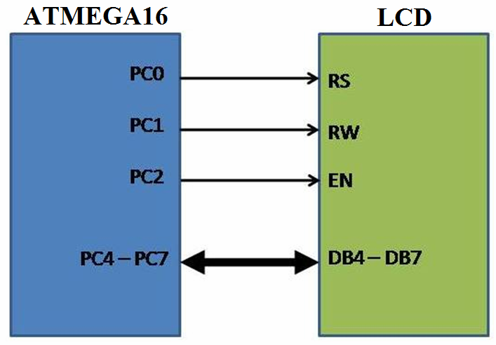
Interfacing LCD with the Microcontroller

Slide 8
LCD Initialization Command
Description | HEX
Function set (8-bit interface, 2 lines, 5*7 Pixels) | 38
Function set (4-bit interface, 2 lines, 5*7 Pixels) | 28
Clear display screen | 01
Return Home (First line first block) | 02
Display ON cursor Blinking | 0F
Address for Line 1 | 80
Address for Line 2 | C0
Display ON cursor OFF | 0C

Slide 9
To Initialize LCD
Step 1 : Initialize PortC as Output Port
Step 2 : Set Control Lines i.e. RS=0 and RW=0
Step 3 : Send LCD init value
i.e. 0x38 for 8-bit mode OR 0x28 for 4-bit mode
Step 4 : Generate Hi-Low Pulse on Enable Pin of LCD
Step 5 : Send LCD Clear value i.e. 0x01
Step 6 : Send LCD Display On value i.e. 0x0F
Step 7 : Send LCD Cursor Home i.e. 0x02

Slide 10
LCD Functions
In Main Function:
void init_ports();
void lcd_reset();
void lcd_init();
void lcd_wr_command(unsigned char);
void lcd_wr_char(char);
void lcd_line1();
void lcd_line2();
void lcd_string(char*);

Slide 11

Thank
You

